Slide 1
Analyzing Big Data Using Amazon Elastic MapReduce
Srivatsan Ananthakrishnan (1021022)

Slide 2
INTRODUCTION
Amazon Elastic MapReduce(EMR) is an Amazon Web Services tool for big data processing and analysis.
Amazon Elastic MapReduce offers the expandable low-configuration service as an easier alternative to running in-house Cluster Computing.

Slide 3
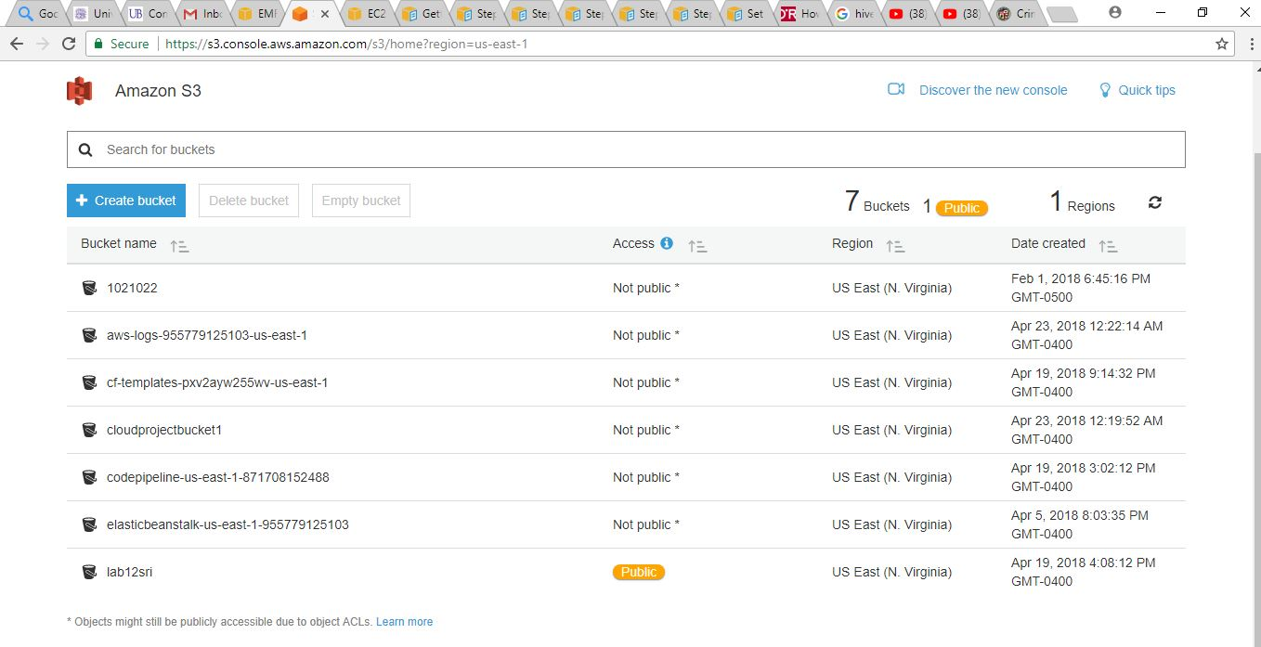
Creating S3 Bucket and EC2 Key Pair

Slide 4
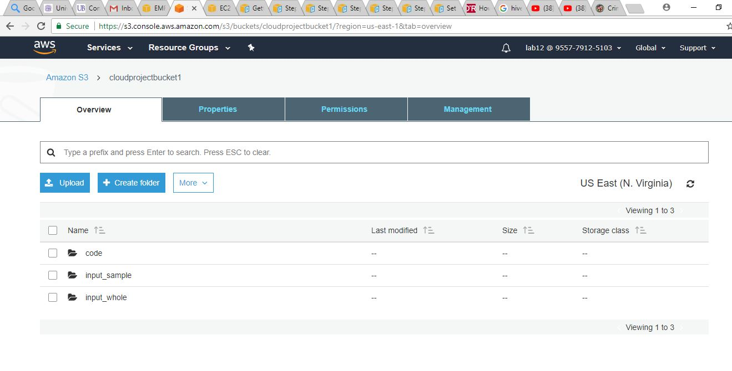

Slide 5
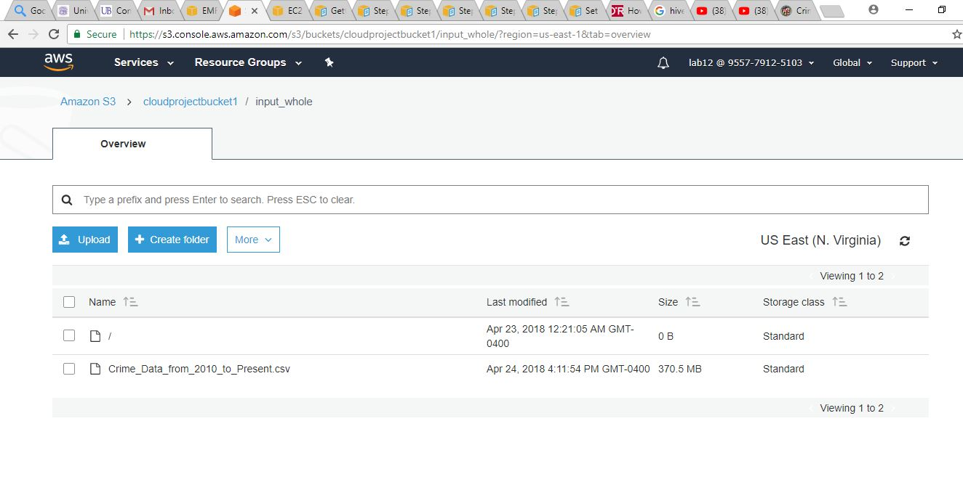

Slide 6
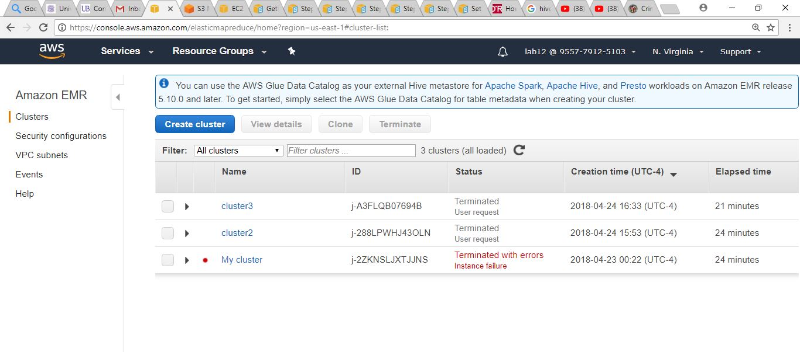
Creating Hadoop Cluster Using EMR

Slide 7
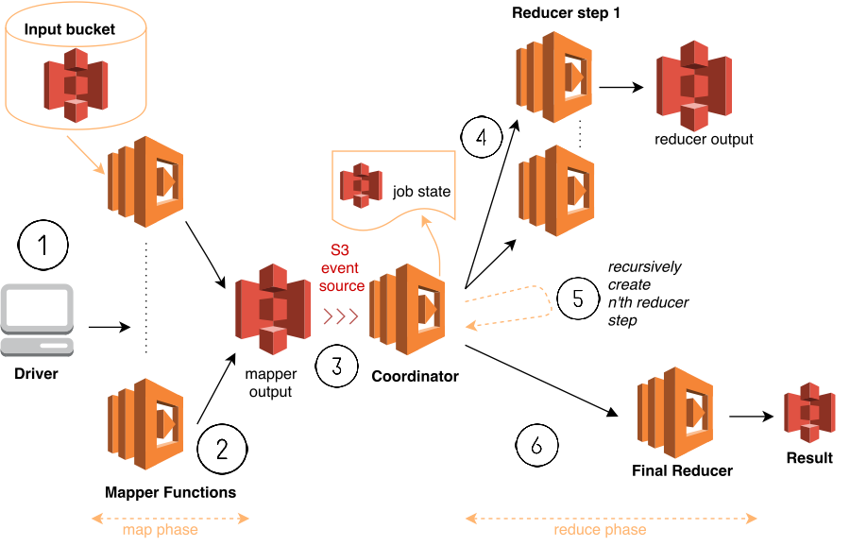
EMR Architecture & Implementation

Slide 8
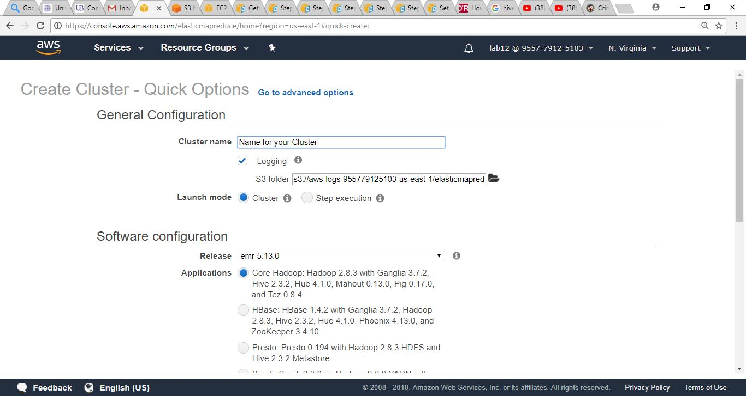

Slide 9
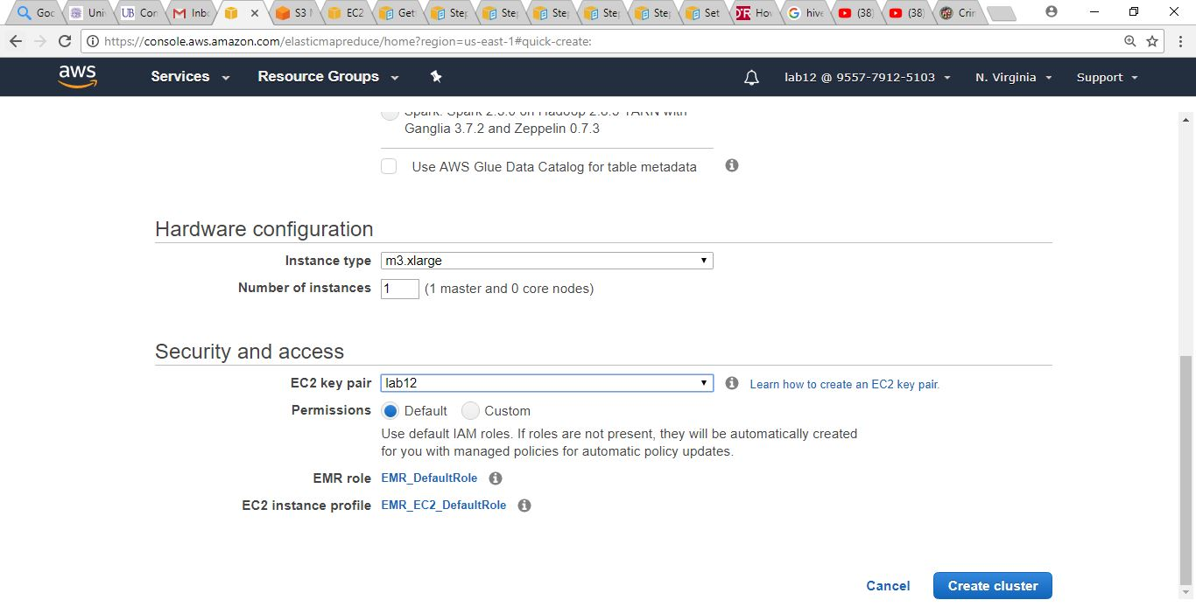

Slide 10
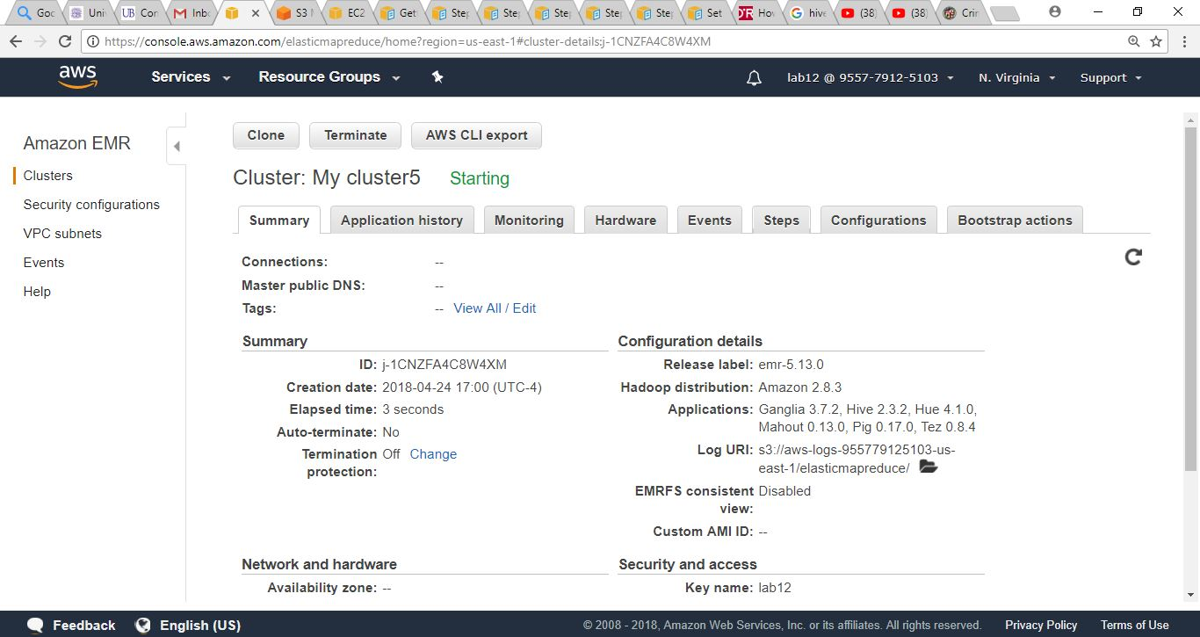

Slide 11
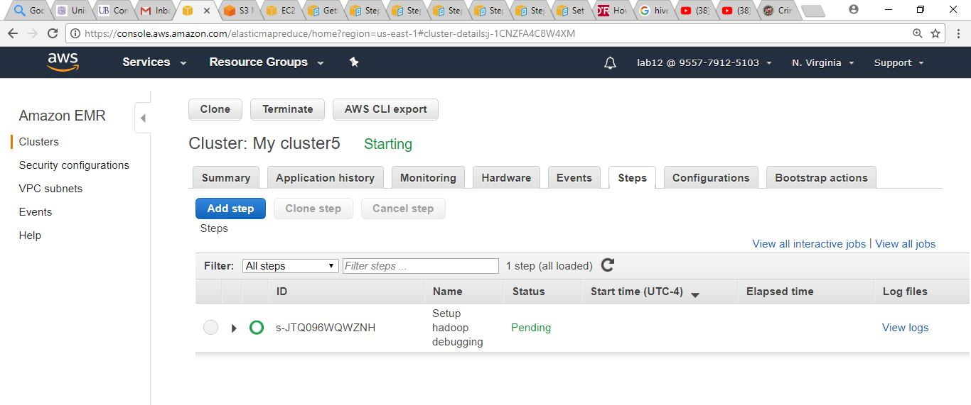

Slide 12
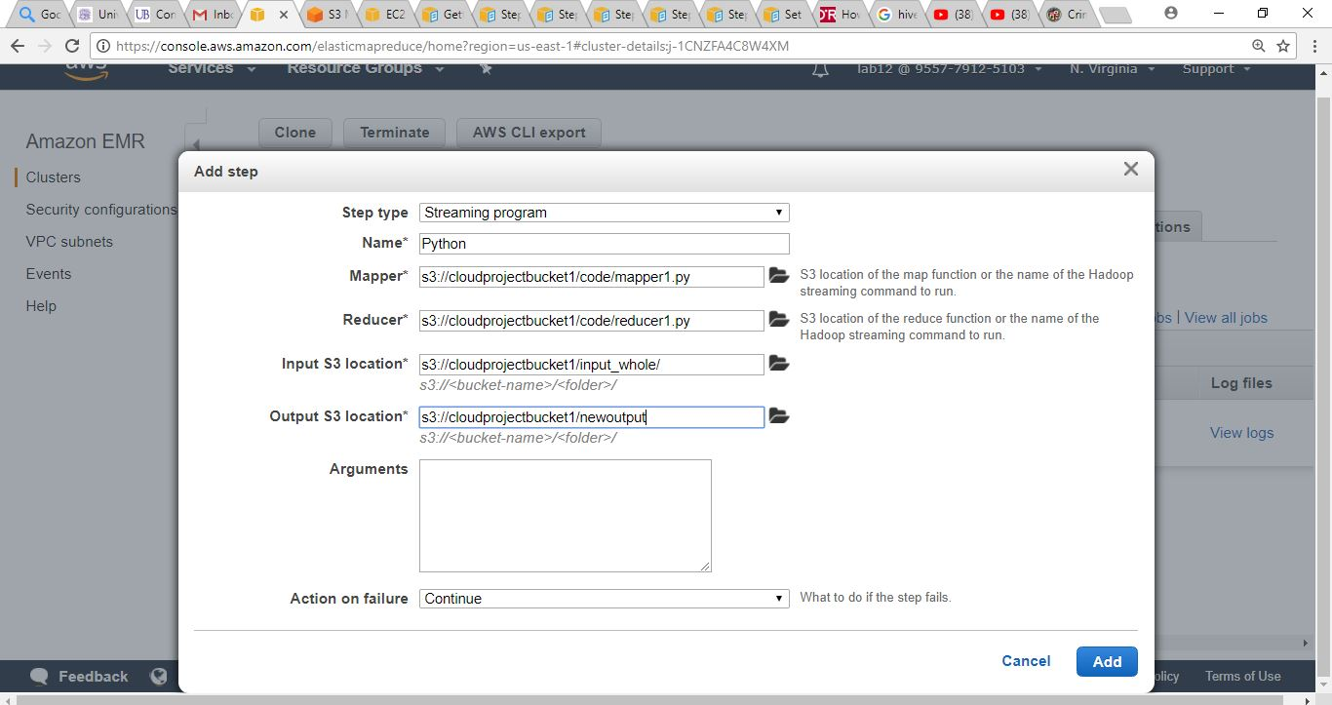

Slide 13
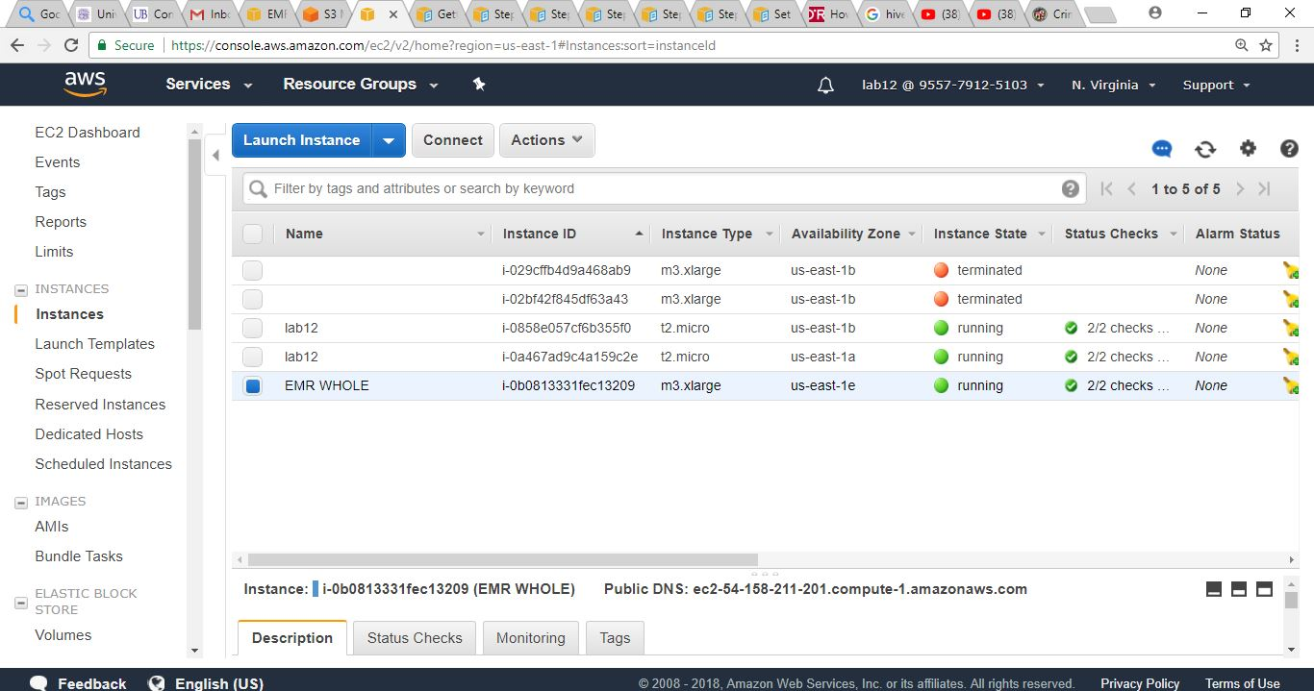

Slide 14
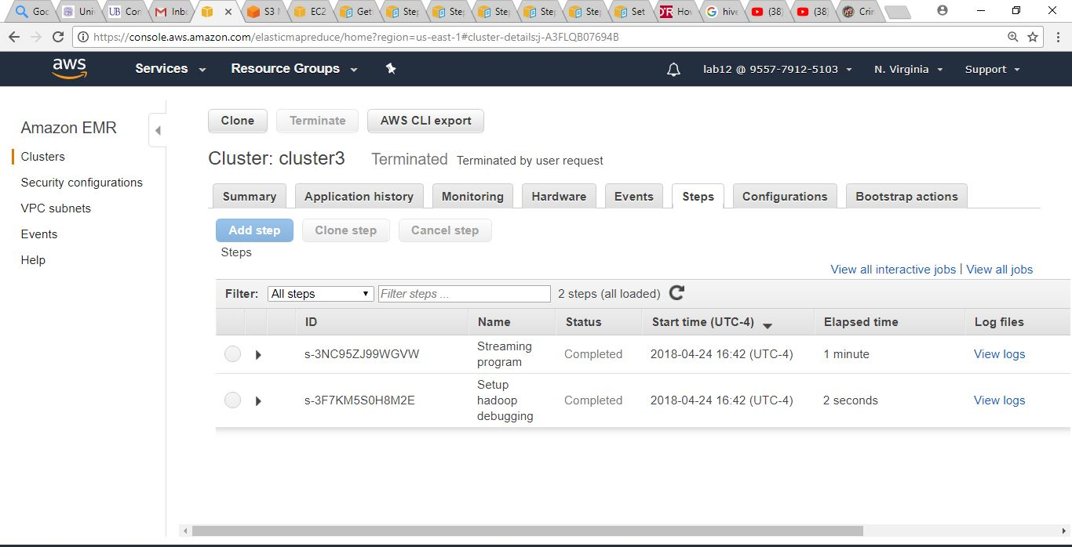

Slide 15
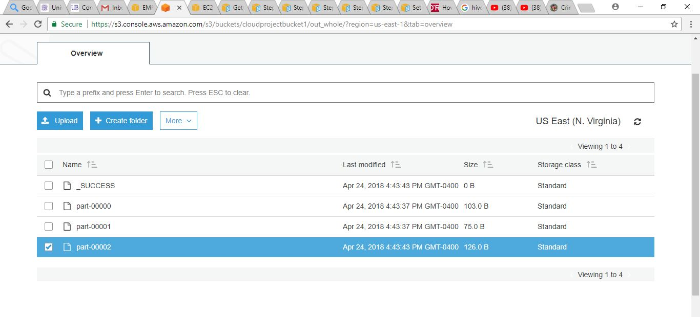

Slide 16
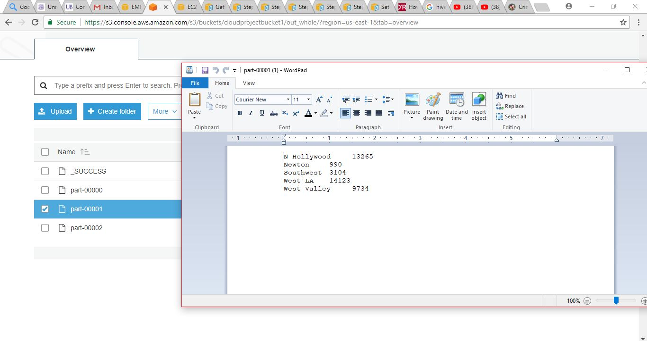

Slide 17
RESET YOUR ENVIRONMENT
Deleting your S3 Bucket.
Terminating your cluster.
THANK YOU! ANY QUESTIONS???????

